Slide 1
Recommedation System POC

Slide 2
Explanation OF Data
We have used 4 Tables
Transactions Table
Articles Table
Customers Table
Images Tables

Slide 3
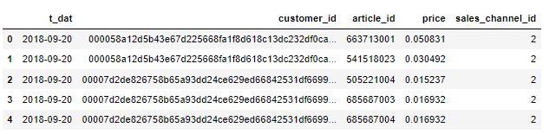
Transaction Table
Transaction Table consists of the purchases each customer for each date, as well as additional information

Slide 4
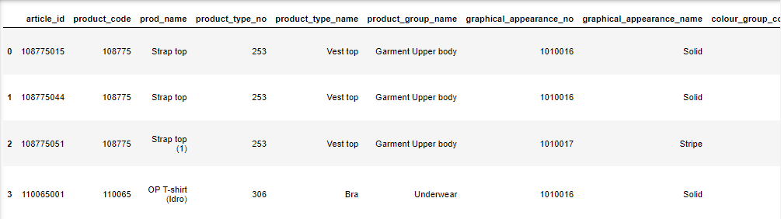
Articles Table
Articles Table consist of various features of the each article ID example: The product type, The color of the product etc

Slide 5
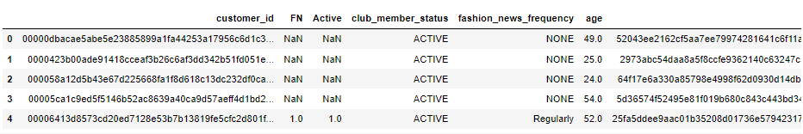
Customers Table
Consists of Details of All the customers

Slide 6
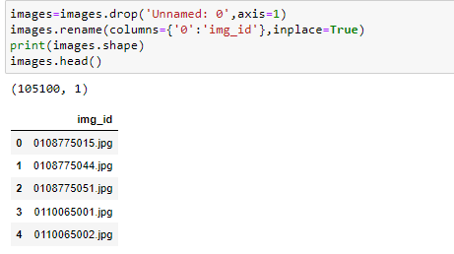
Images
Has all the details of the images present. The Dataset has 105100 images

Slide 7
Algorithms Used For Reccomendation
Annoy (Approximate Nearest Neighbours)
VGG-16

Slide 8
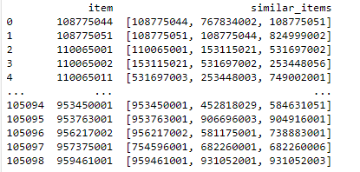
Annoy Algorithm Usage Explained
Annoy Algorithm is used to find out the nearest similar items to any given item based on the minimum distance in the vector space.
Example:
Here We have calculated K=3 nearest items of each article.

Slide 9
Evaluation Of Annoy Algorithm
We perform evaluation based on the factor of Relevant Recommendation.
For example if we have evaluate the Prediction of the similar item of a product with article id 108775044.
We first convert the articleid of 108775044 to which category it belongs. For example if it is a polo shirt.
We then calculate how many of the items in the similar items belongs to the category of polo shirt.

Slide 10
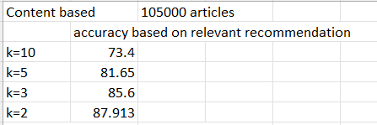
Results Of Annoy Algorithm

Slide 11
VGG16
VGG16 is used to Extract 4096 Different features from each image.
We then use cosine similarity in order to find the n similar images.
We have built the VGG16 model for 5000 images

Slide 12
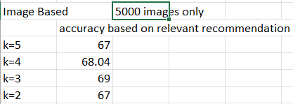
Results OF VGG16
We perform evaluation based on the factor of Relevant Recommendation.
For example if we have evaluate the Prediction of the similar item of a product with article id 108775044.
We first convert the articleid of 108775044 to which category it belongs. For example if it is a polo shirt.
We then calculate how many of the items in the similar items belongs to the category of polo shirt.

Slide 13
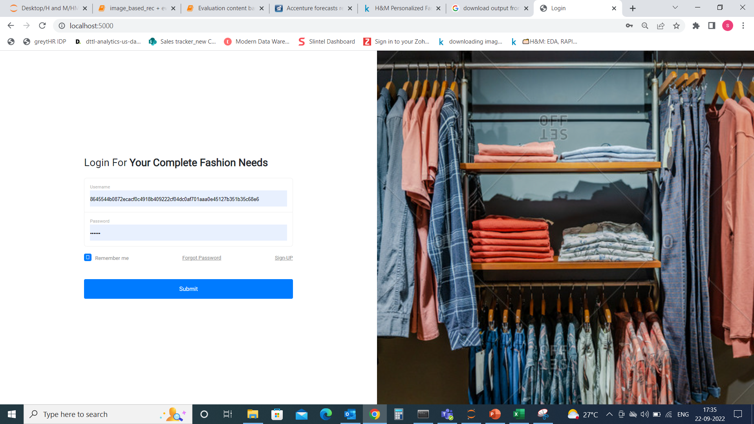
Front End

Slide 14
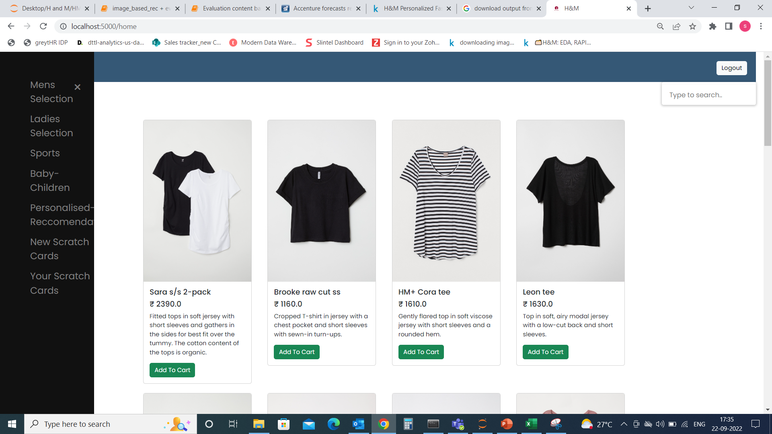
Products Page

Slide 15
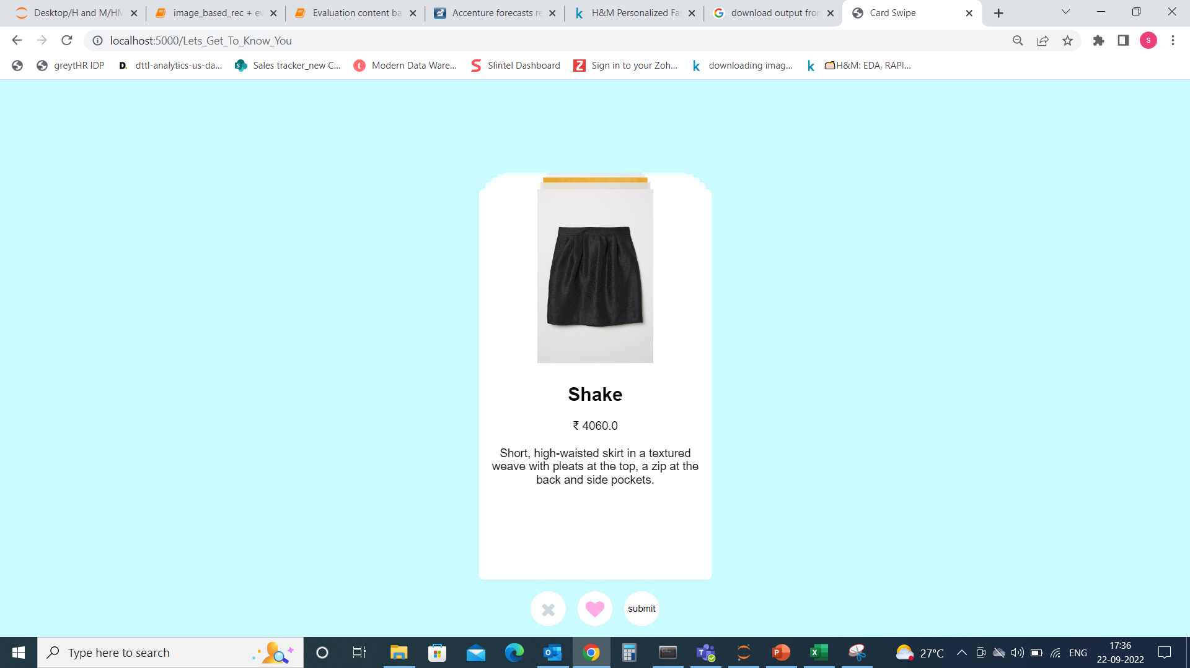
Right Swipe You Like Game

Slide 16
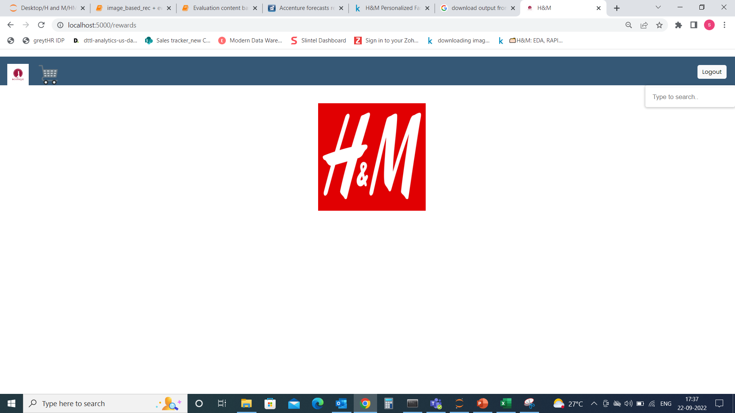
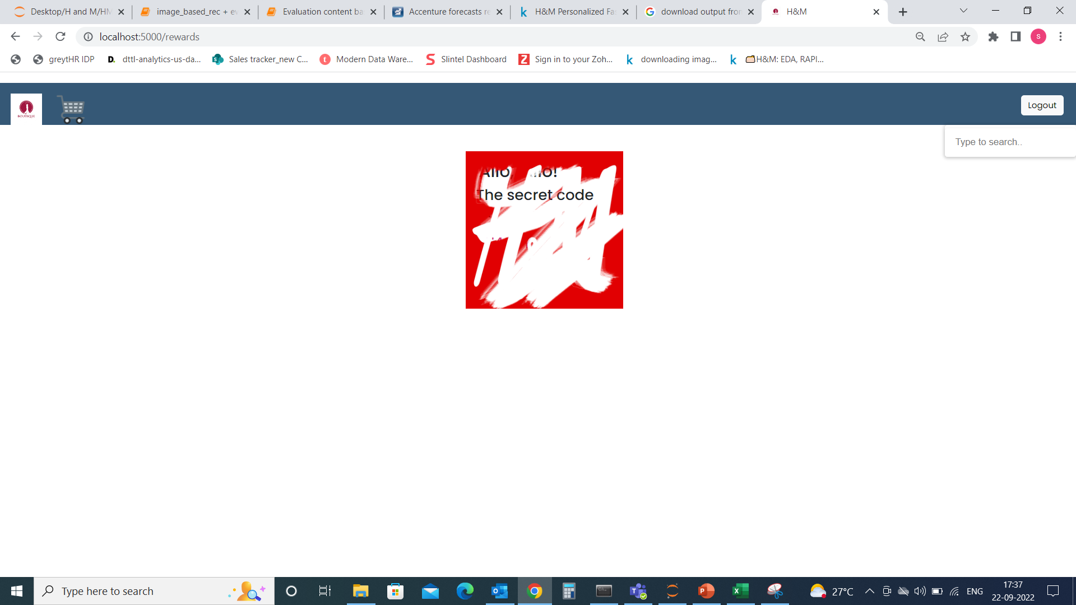
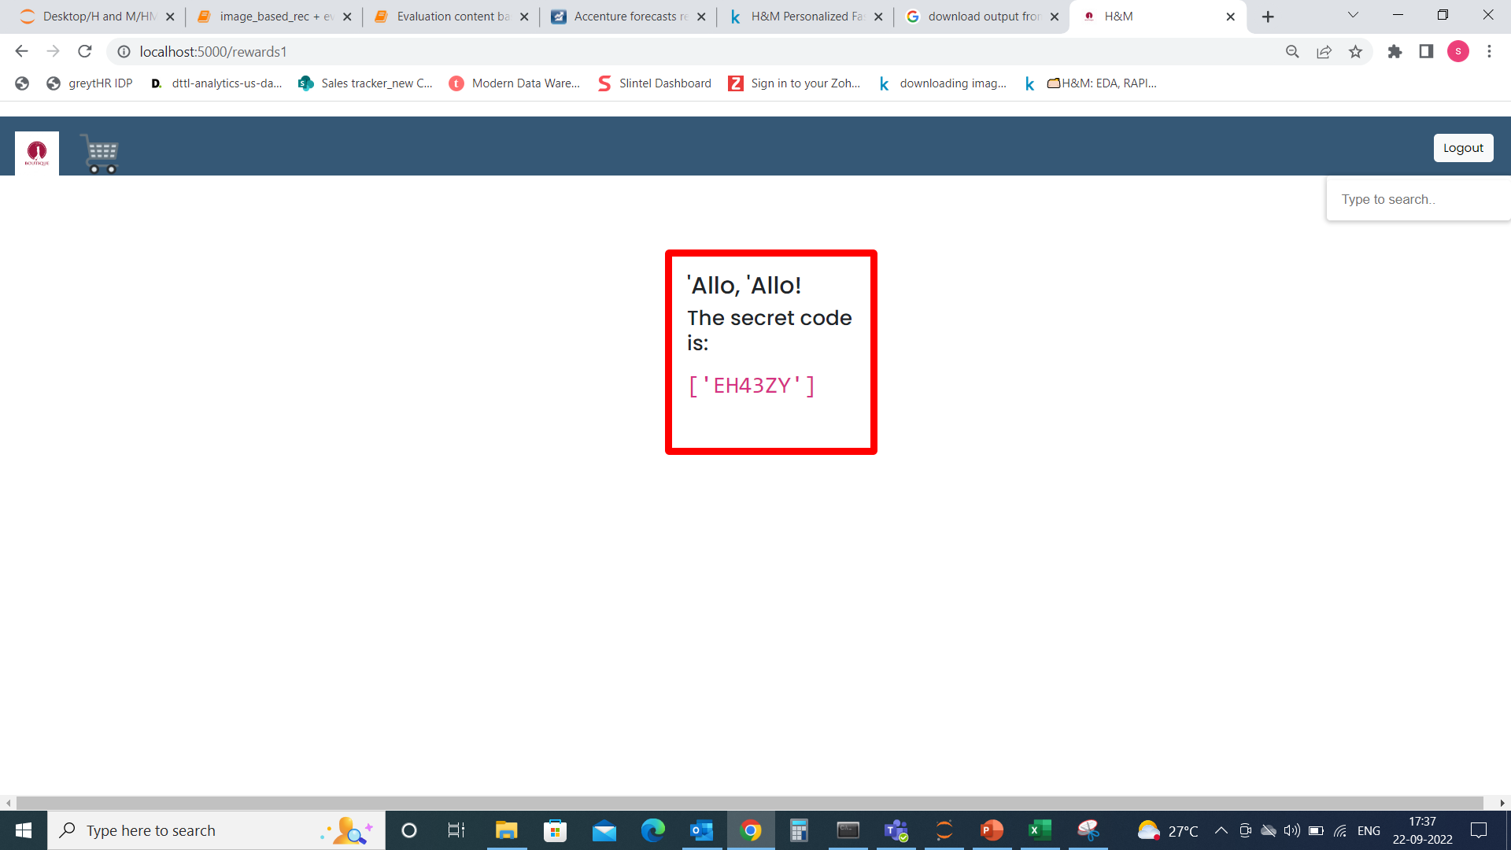
Scratch Cards

Slide 17
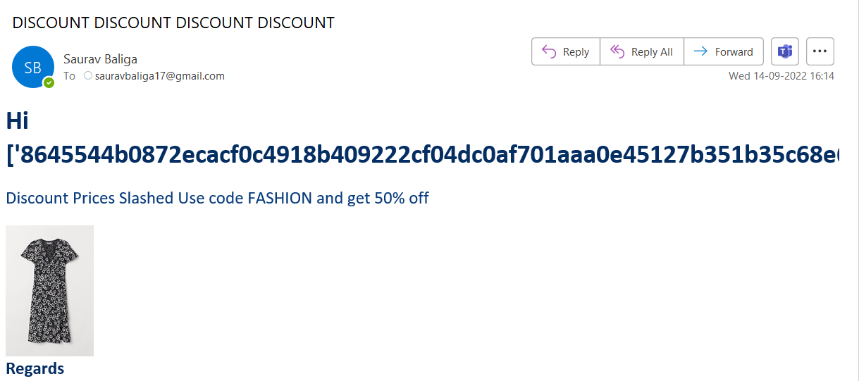
Targeted Marketing Mail With Tracker

Slide 18
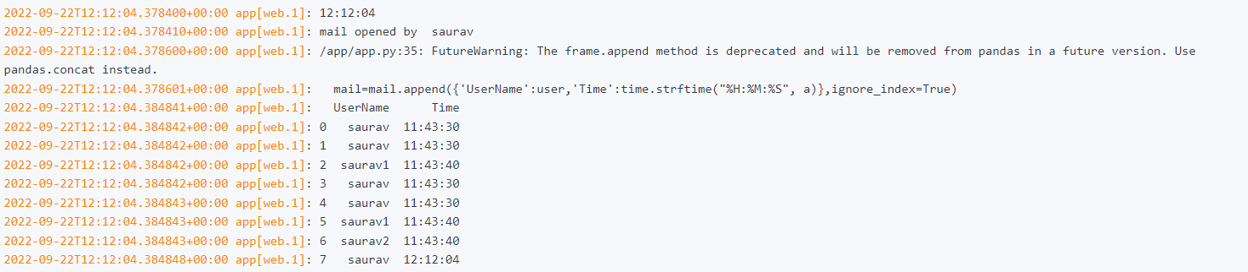
Tracking whether the customer has opened the mail of not

